Slide 1


Docker
The Docker Container

Slide 2
Lesson Agenda
To Understand the functions of a docker container

Slide 3
Introduction
A container is the runtime instance of an image.
you start one or more containers from a single image.
The big difference between a VM and a container is that containers are faster and more lightweight — instead of running a full-blown OS like a VM, containers share the OS/kernel with the host they’re running on.

Slide 4
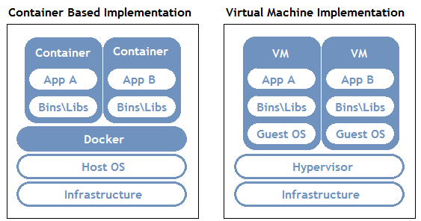

Slide 5
docker container run
When you hit Return, the Docker client packaged up the command and POSTed it to the API server running on the Docker daemon. The Docker daemon accepted the command and searched the Docker host’s local image repository to see if it already had a copy of the requested image.
Once the image was pulled, the daemon instructed containerd and runc to create and start the container

Slide 6
Anatomy of a container
Let us execute some basic commands on a container
docker container run -it ubuntu:latest /bin/bash
ls –l
ping www.google.com
images are optimized to be lightweight.
don’t have all of the normal commands and packages installed.
The first command runs and second command fails.
killing the main process in the container will kill the container.
Press Ctrl-PQ to exit the container without terminating its main process. Doing this will place you back in the shell of your Docker host and leave the container running in the background.

Slide 7
Container Lifecycle
docker container run --name MyContainer -it ubuntu:latest /bin/bash
A new container is created and we give it a name MyContainer
Containers are designed to be immutable objects and it’s not a good practice to write data to them.
docker container stop MyContainer
Stop the container started earlier
docker container rm MyContainer
Remove the container
docker container rm <container> -f
Removes a running container
This is a force stop and any ongoing process is killed
The stop and remove method earlier allows the container 10sec to finish its work

Slide 8
Restart policy
It’s often a good idea to run containers with a restart policy. This is a form of self-healing that enables Docker to automatically restart them after certain events or failures have occurred.
Restart policies are applied per-container, and can be configured imperatively on the command line as part of docker-container run commands, or declaratively in YAML files for use with higher-level tools such as Docker Swarm, and Kubernetes.
following restart policies exist:
always
unless-stopped
on-failed

Slide 9
Restart Policy cont.
The always policy is the simplest. It always restarts a stopped container unless it has been explicitly stopped, such as via a docker container stop command.
docker container run --name alwaysPol -it --restart always alpine sh
Type exit to stop the container after a few seconds.
Once you’ve exited the container and are back at your normal shell prompt, check the container’s status.
docker container ls
See the difference in created and status time period
This is because the exit command killed it and Docker restarted it. if you inspect it with docker container inspect you can see the restartCount has been incremented.

Slide 10
Restart Policy cont.
you start a new container with the --restart always policy and then stop it with the docker container stop command. At this point the container is in the Stopped (Exited) state. However, if you restart the Docker daemon, the container will be automatically restarted when the daemon comes back up.
The main difference between the always and unless-stopped policies is that containers with the --restart unless-stopped policy will not be restarted when the daemon restarts if they were in the Stopped (Exited) state.
The on-failure policy will restart a container if it exits with a non-zero exit code. It will also restart containers when the Docker daemon restarts, even containers that were in the stopped state.

Slide 11
Demonstration
Let us try to test the restart policies

